Slide 1
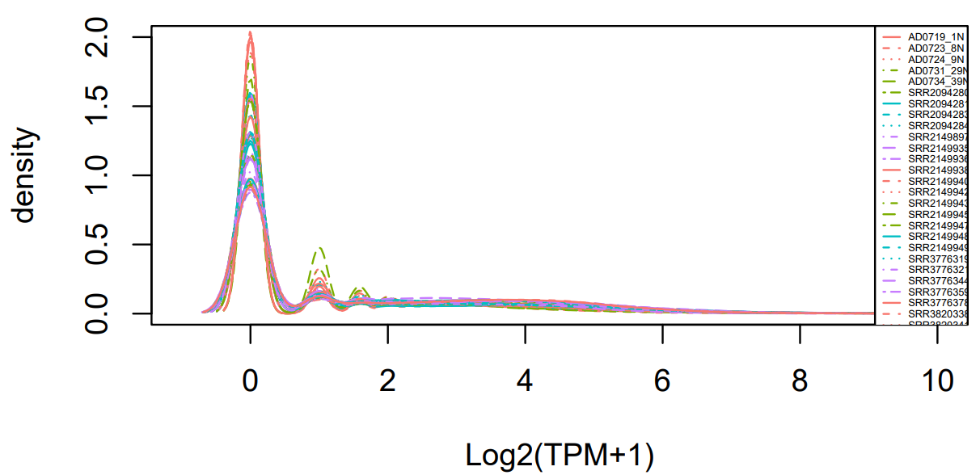
Density Plot

Slide 2
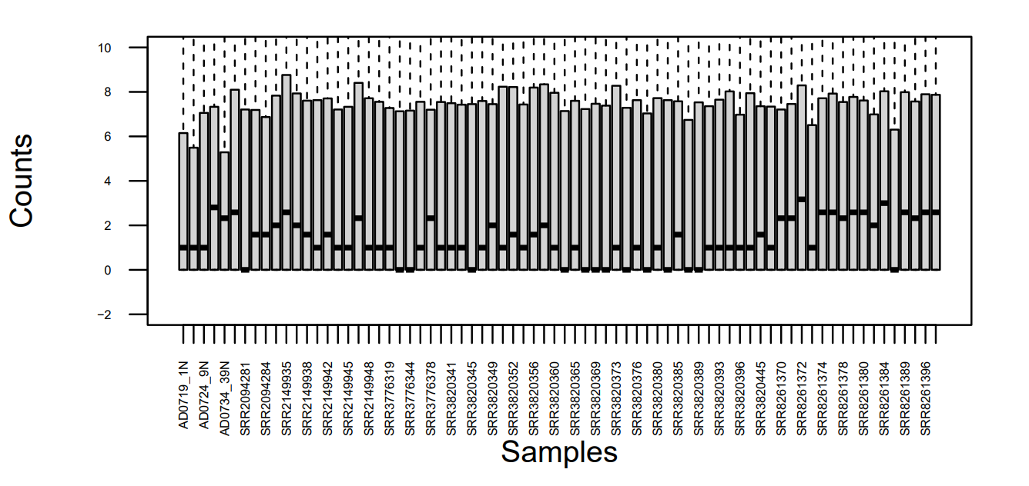
BEFORE COMBAT (after adjustment)

Slide 3
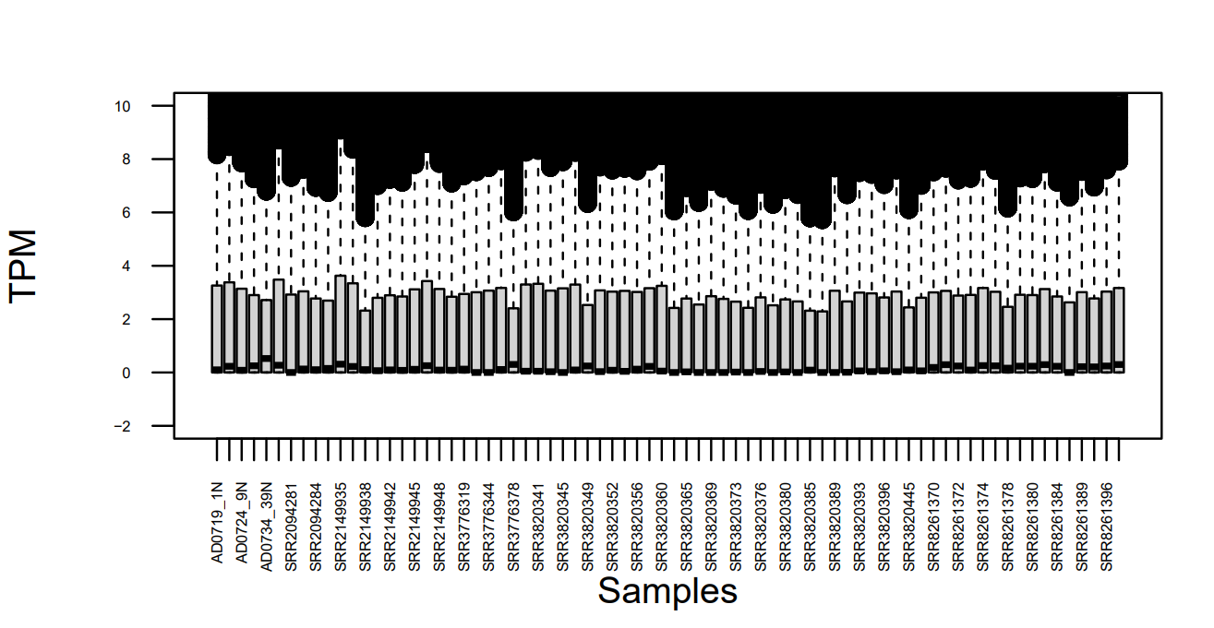
AFTER COMBAT (after adjustment)

Slide 4
LIST OF THE TOP 20 GENES | TOP 20 GENES EXPRESSED | Tumor samples-genes>1.5 (TOTAL 9530 GENES) | Tumor samples-genes>2 (TOTAL 4769 GENES)
MMP13 | NUMBER | 12 | 10
AMTN | SYMBOL | AMTN | AMTN
MMP10 |  | CASC9 | CASC9
LAMC2 |  | CDKN2A | KRT6B
PTHLH |  | KRT6B | LAMA3
SPINK6 |  | LAMA3 | LAMB3
KLHDC7B |  | LAMB3 | LAMC2
MMP11 |  | LAMC2 | MAGEA4
RP11-805J14.5 |  | MAGEA4 | MMP11
KRT17 |  | MMP11 | MMP12
MAGEA4 |  | MMP12 | PTHLH
NTS |  | MMP13
LAMB3 |  | PTHLH
MMP12
KRT6B
CDKN2A
KLK14
LAMA3
CASC9
C6orf15

